Slide 1
Welcome to PerfectServe!

Slide 2
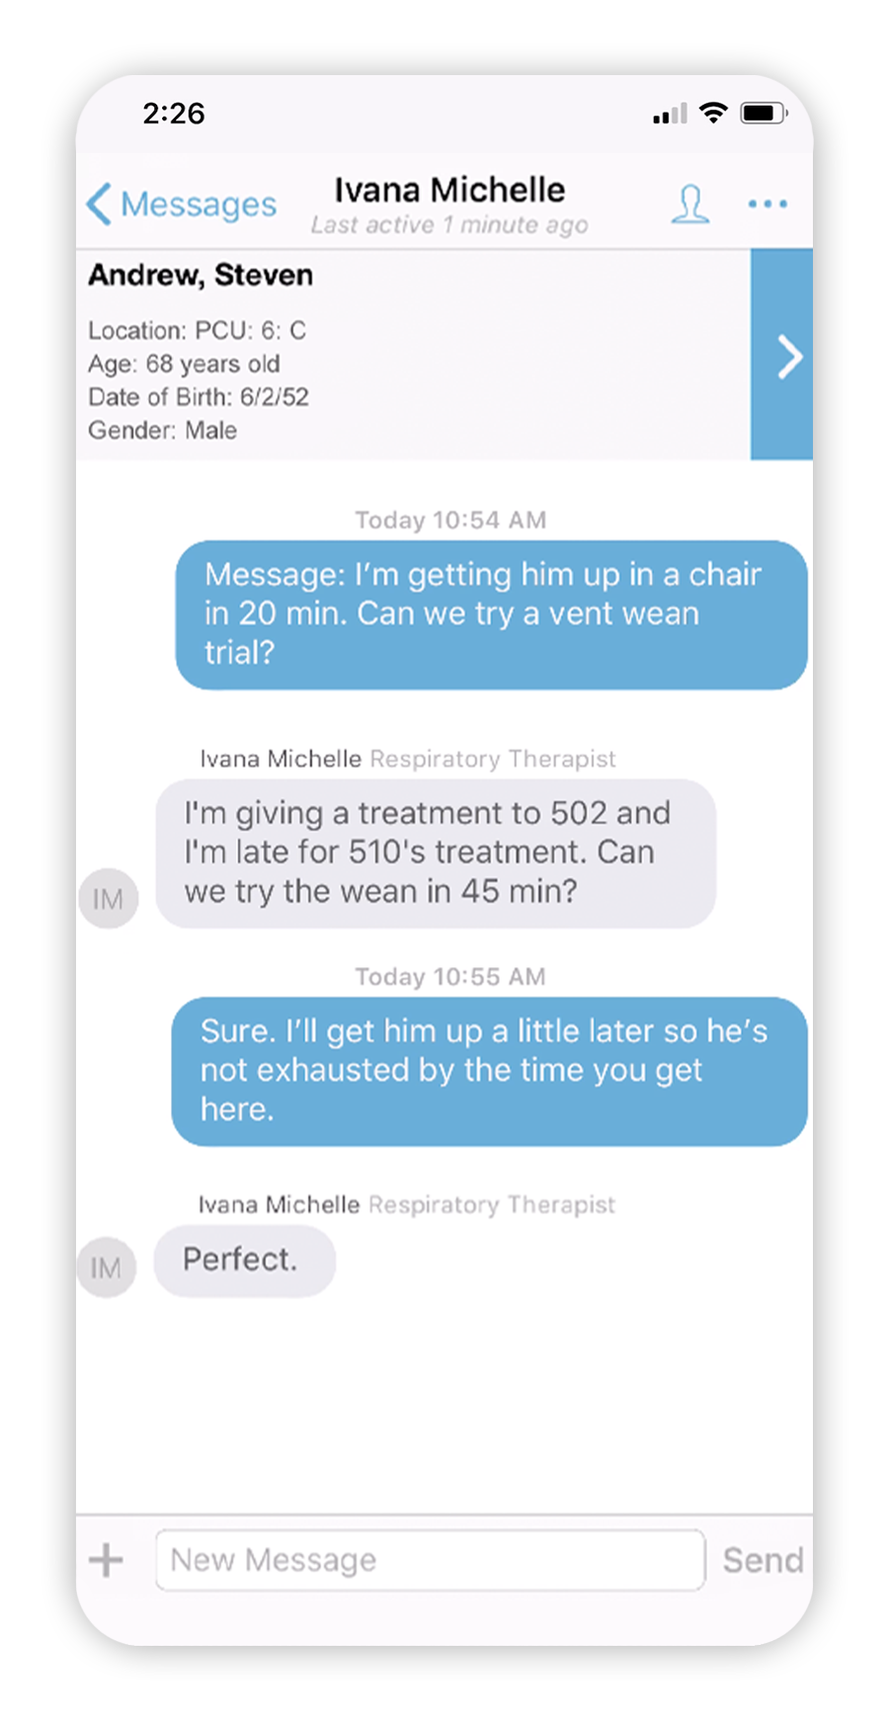
PerfectServe is Coming!
Ever have difficulty …
Contacting the right on-call provider?
Verifying that a care team member received and read your message?
Redirecting a message when you’re off call or unavailable?
With PerfectServe’s Telmediq solution, you can quickly and easily reach the right team member at the right time using the right contact method.

Slide 3
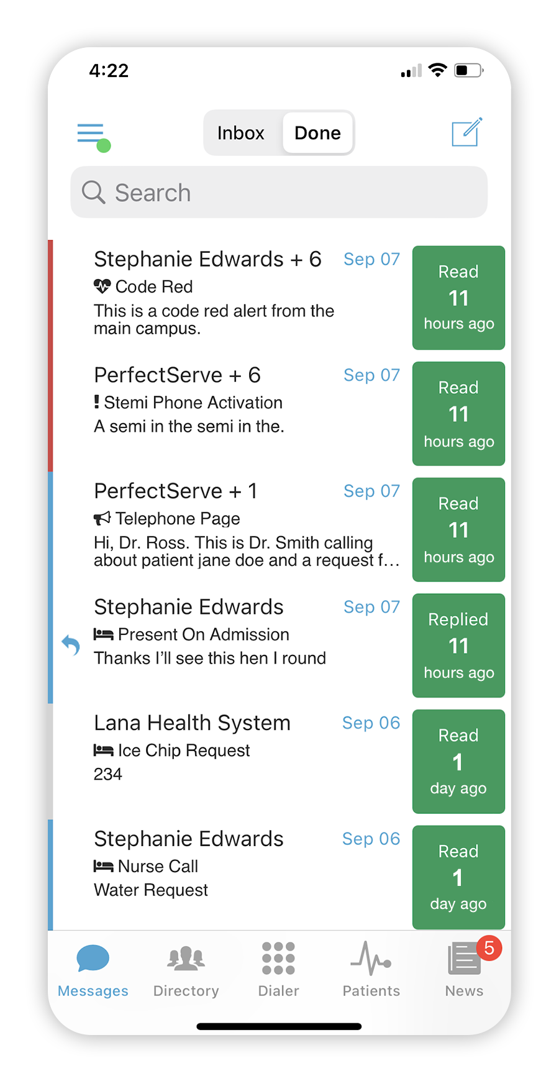
Ever Wonder If They Got Your Message?
With PerfectServe, you can be sure that your messages always get delivered!
PerfectServe allows users to:
Track messages
Easily find read receipts for messages sent
Manage conversations and forward messages
Set an auto response or forward your messages when you’re unavailable
Easily locate an on-call provider

Slide 4
Why PerfectServe?
Deploying a new communication platform is a big deal. We’re making the switch because PerfectServe:
Is available on mobile devices and workstations
Connects all clinicians on a single platform
Ensures messages are delivered to the correct clinician the first time
Supports live on-call schedules that can be updated in real time
Allows nurses to send secure messages and make phone calls
Makes it possible for care team members to exchange secure messages

Slide 5
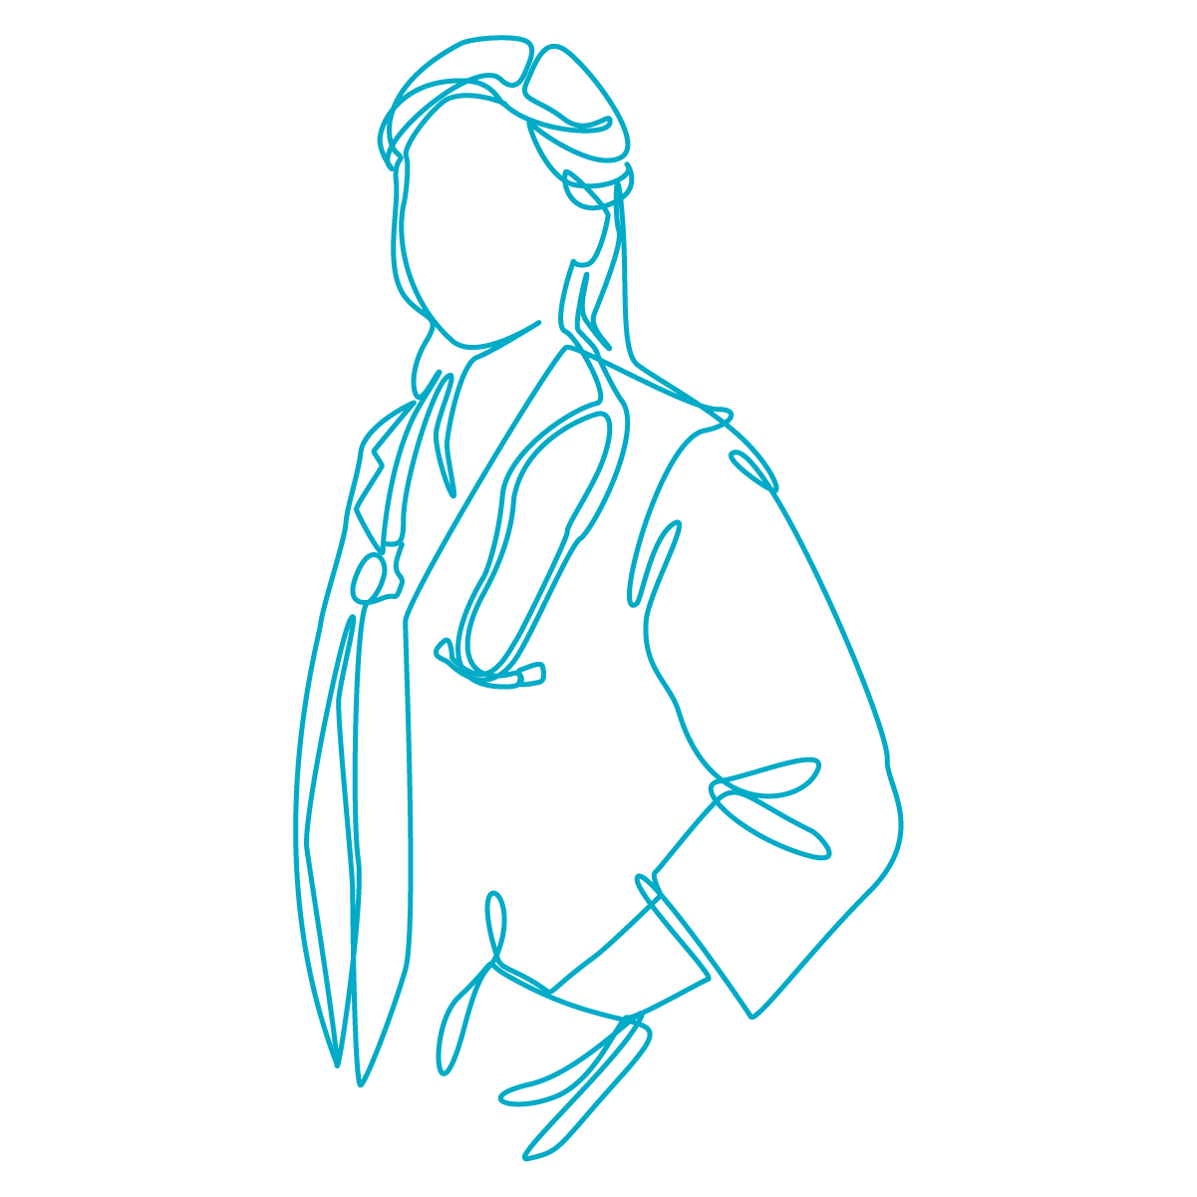
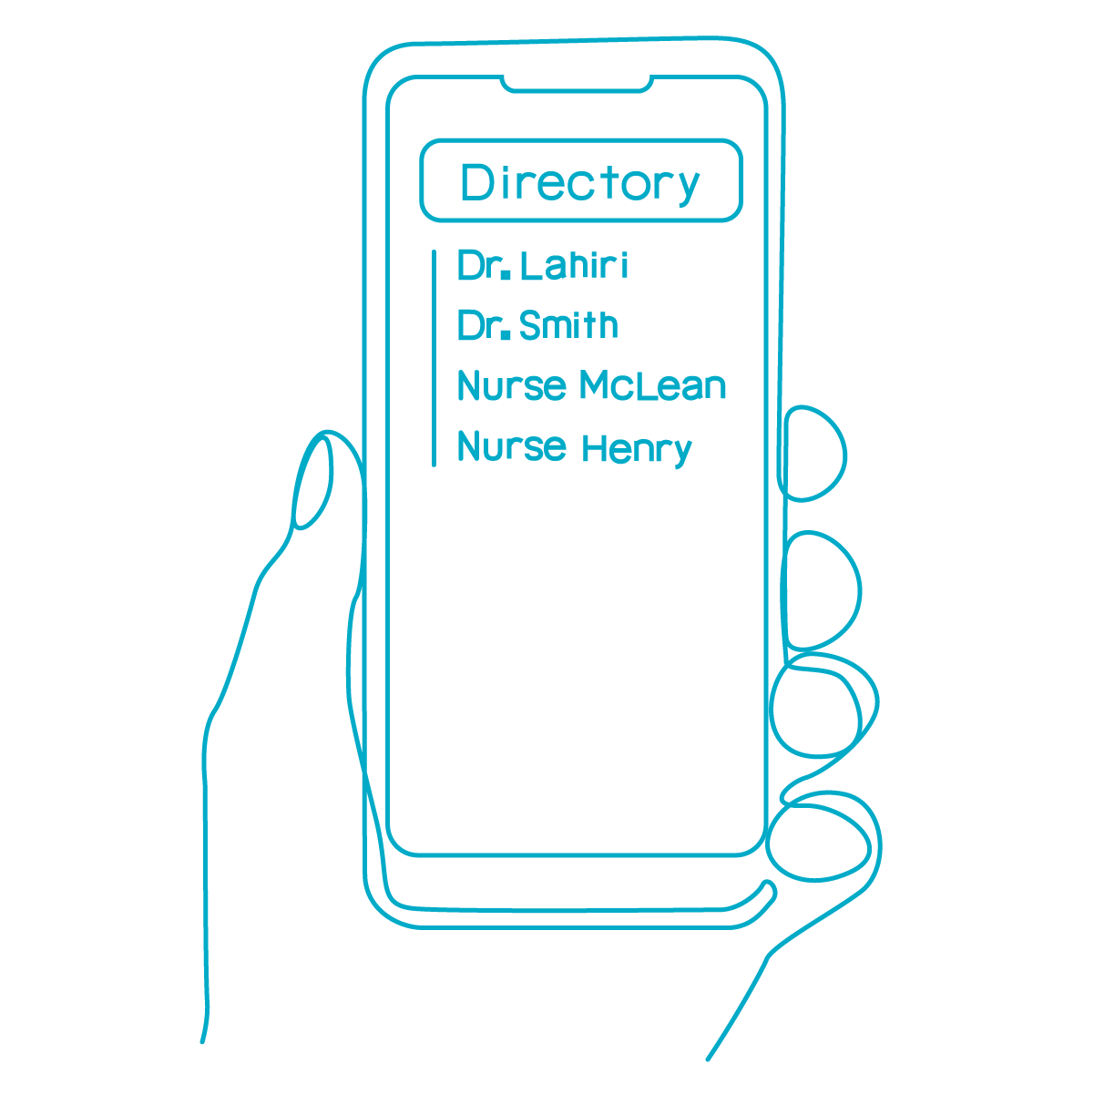
Smarter Communication
Customized Algorithms
Patient-Centered Access
Messages are routed using workflow rules, call schedules, and contact preferences.
Instantly shows and connects you to the team members caring for a patient at any given time.
Multimodal Approach
Responsive Escalation
Advanced Search
Supports all devices (smartphones, web browsers, pagers, etc.) and communication pathways (text, call, video).
Predefined protocols ensure that no message is missed.
Allows you to easily connect with any team member inside your organization.

